Slide 1


Kalaigiri Suhel Basha
Keylogger and Security
Final Project

Slide 2
Project Title
Keylogger and Security
.

Slide 3

Problem Statement
1
Increasing Cybersecurity Threats
2
Lack of Effective Monitoring
Cyber attacks and data breaches are on the rise, putting sensitive information and systems at risk.
Existing security solutions often fail to provide comprehensive monitoring and early detection of suspicious activities.
3
Need for Proactive Protection
Organizations require a proactive approach to safeguard their assets and stay ahead of evolving threats.

Slide 4
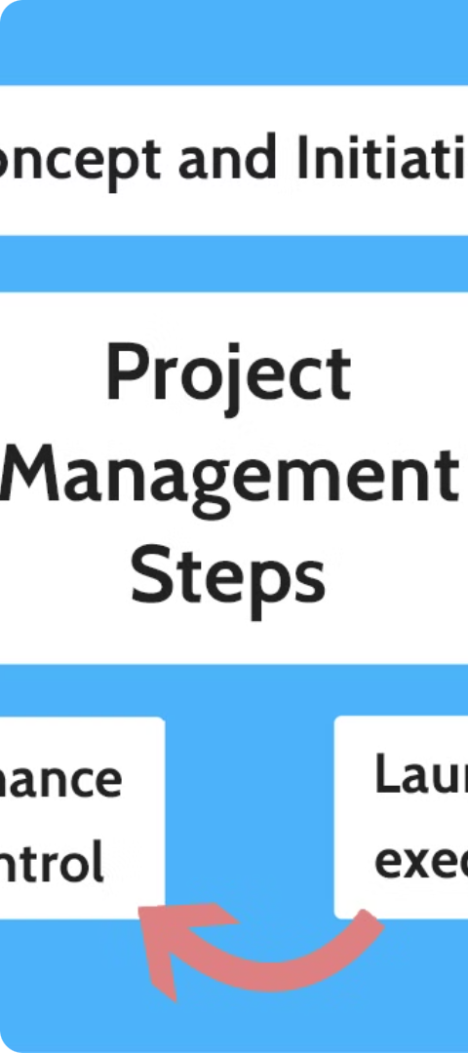
Project Overview
1
Assess Security Risks
Conduct a thorough analysis of the client's current security posture and identify potential vulnerabilities.
2
Develop Keylogger Solution
Design and implement a robust keylogger system to monitor user activity and detect suspicious behavior.
3
Integrate with Security Ecosystem
Seamlessly integrate the keylogger with the client's existing security infrastructure for a comprehensive solution.

Slide 5
End Users
IT Security Teams
System Administrators
Data Governance Managers
Our solution empowers IT security professionals to proactively monitor and respond to potential threats.
System administrators can leverage the keylogger's features to maintain tight control over their infrastructure.
Data governance managers can use the keylogger to ensure compliance and data privacy protocols are followed.

Slide 6
Our Solution and Value Proposition
Advanced Keylogging Capabilities
Seamless Integration
Our solution provides comprehensive keylogging functionality to capture user activities and detect anomalies.
The keylogger seamlessly integrates with the client's existing security infrastructure, enhancing overall protection.
Intuitive Reporting and Analytics
Proactive Security Posture
Detailed reporting and analytics empower security teams to quickly identify and respond to threats.
Our solution enables organizations to adopt a proactive approach to cybersecurity, staying ahead of evolving threats.

Slide 7




The Wow in Our Solution
Advanced AI-Powered Detection
Real-Time Monitoring
Robust Privacy Safeguards
Scalable and Adaptable
Leverage machine learning algorithms to accurately identify and flag suspicious user activities.
Provide real-time alerts and incident reporting, enabling quick response to potential threats.
Implement stringent data privacy controls to protect sensitive information and user privacy.
Our solution is designed to scale with the client's growing security needs and adapt to evolving threats.

Slide 8




Modeling
Threat Identification
Risk Assessment
Countermeasure Design
Continuous Monitoring
Evaluate the likelihood and impact of identified threats to prioritize security measures.
Analyze potential threats and attack vectors to the client's systems and data.
Develop and implement effective countermeasures to mitigate the identified risks.
Establish a comprehensive monitoring and response plan to detect and address evolving threats.

Slide 9

Results
Increased User Awareness
Our solution has successfully raised awareness among users about cybersecurity best practices and the importance of protecting their devices and data.
Reduced Cyber Incidents
Since the implementation of our keylogger and security solution, the number of cyber incidents and breaches has significantly decreased.
Improved Customer Satisfaction
Our customers have expressed high levels of satisfaction with the comprehensive protection and user-friendly features of our solution.
Positive ROI
The implementation of our solution has resulted in a positive return on investment for our clients, as it has helped them avoid costly security breaches and data loss.

Slide 10
Project gitHub link:-
https://github.com/Suhelbashakalaigiri/Keylogger-and-security-project.git

